Slide 1

Exploratory Data Analysis
Bank Marketing (Campaign)
January 30, 2023

Slide 2
TEAM MEMBER
Name: Giovanna Vieira
E-mail: giihvieira1703@gmail.com
Country: Brazil
College/Company: Hashtag Treinamentos
Specialization: Data Science

Slide 3
Problem Statement
Data Analysis
Data Cleaning
EDA
Encoding
Models
Final Recommendations
GitHub Repo Link
Agenda

Slide 4
Overview
ABC Bank wants to sell its term deposit product to customers and before launching the product they want to develop a model which help them in understanding whether a particular customer will buy their product or not (based on customer's past interaction with bank or other Financial Institution).
Solution
By analysing the dataset we will be able to convert this problem into a machine learning classification and build a model to predict whether a client will subscribe a term deposit or not.
Problem Statement

Slide 5
Data Analysis
21 Features
41188 rows
Assumptions:
The data seems to be cleaned and a little bit skewed, however you can see that the variables have outliers that need to be cleaned with data cleaning process.
There are no null values, but there are some "unknown" values.
We’ve got 41188 rows, some of the columns has 85% of the values repeated.
The value types seem to be correct but as said there are some “unknown” values.

Slide 6
Data Cleaning
The most used techniques to treat the data frame were:
Dropping columns and rows
Replacing missing values with the mode
Filling outliers with ffill/bfill based on interquantile range
Grouping text features that doesn’t appear many time
Cleaned dataset reduced from (41188, 21) to (40165, 18)

Slide 7
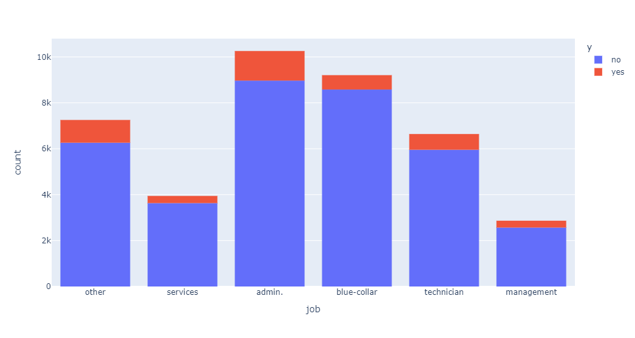
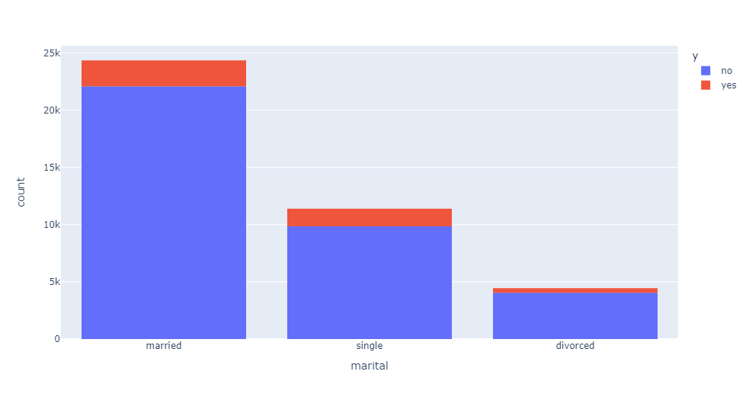
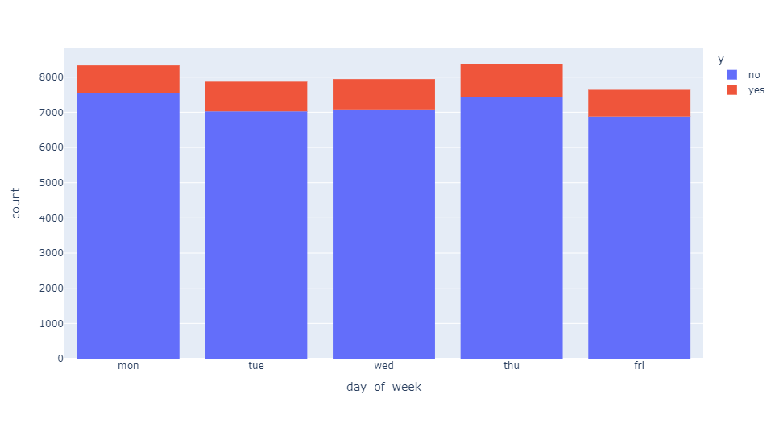
EDA – Categorical Attributes
Job: Highest number of subscriptions to a term deposit work on admin.
Marital: Most of the clients approached were married.
Day of Week: There's no significant difference in the numbers of clients approached and people subscribed.

Slide 8
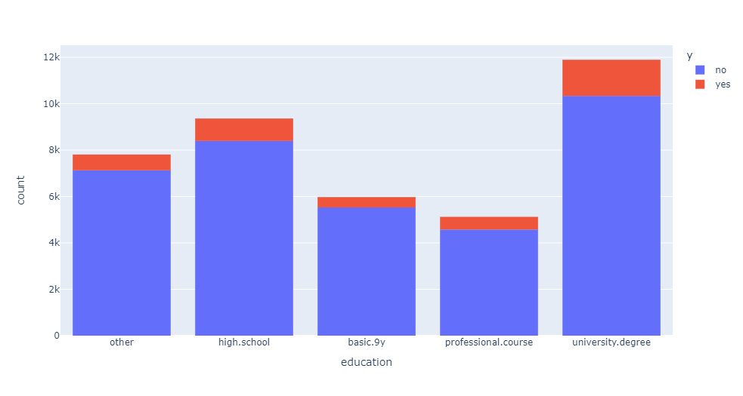
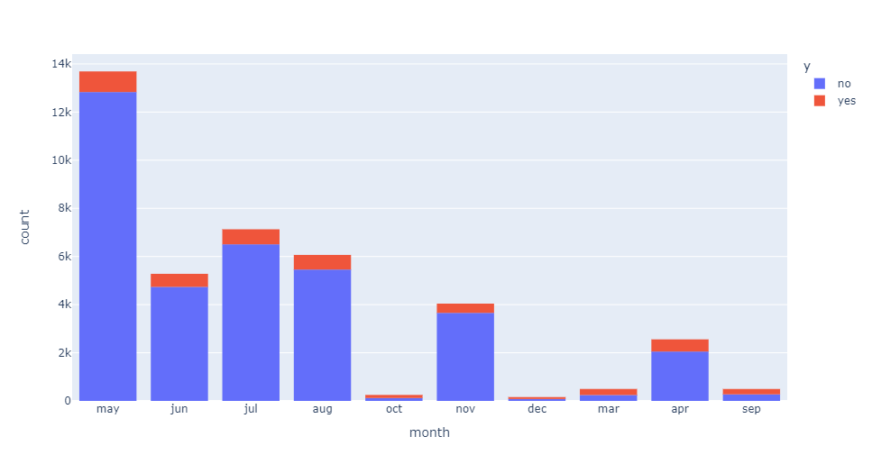
EDA – Categorical Attributes
Education: In the education column we can see that most people who has subscribed have a university degree.
Month: The last contact month of year was way bigger in may.

Slide 9
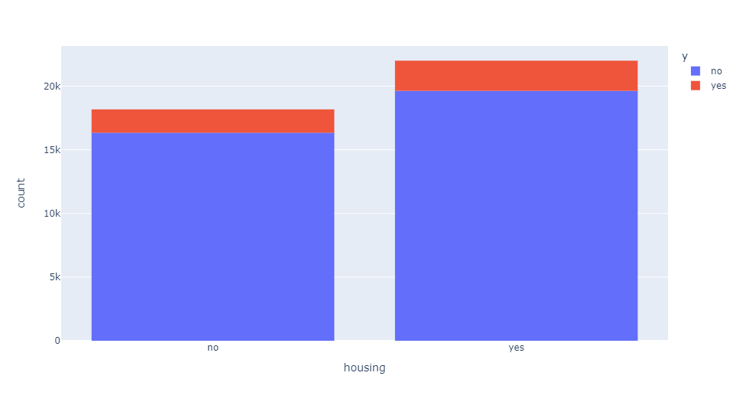
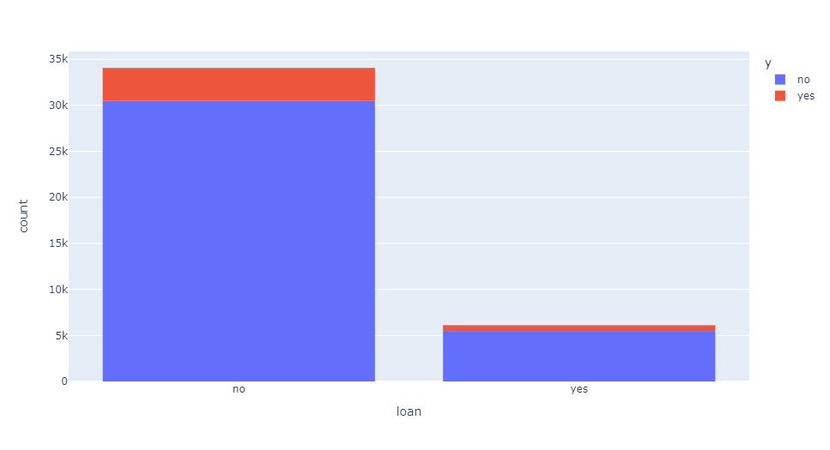
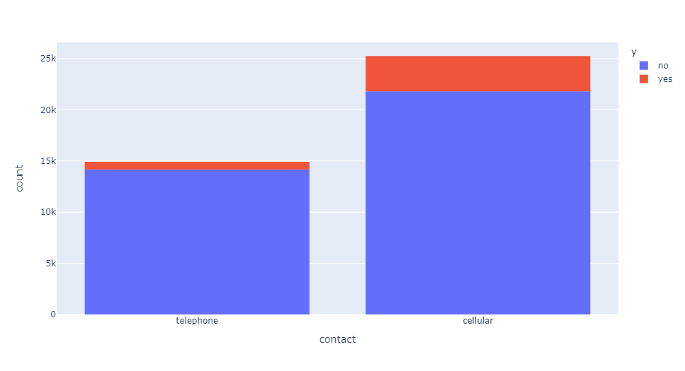
EDA – Numerical and Other Attributes
Housing: A housing loan does not have much of effect on the number of term deposits purchased.
Loan: Most of the clients approached did not have a personal loan.
Contact: The contact by phone seems to be more effective.

Slide 10
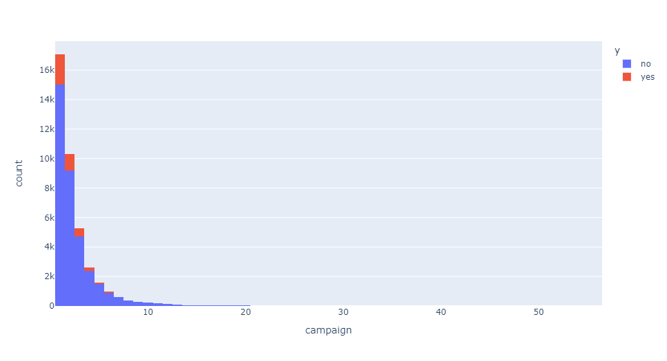
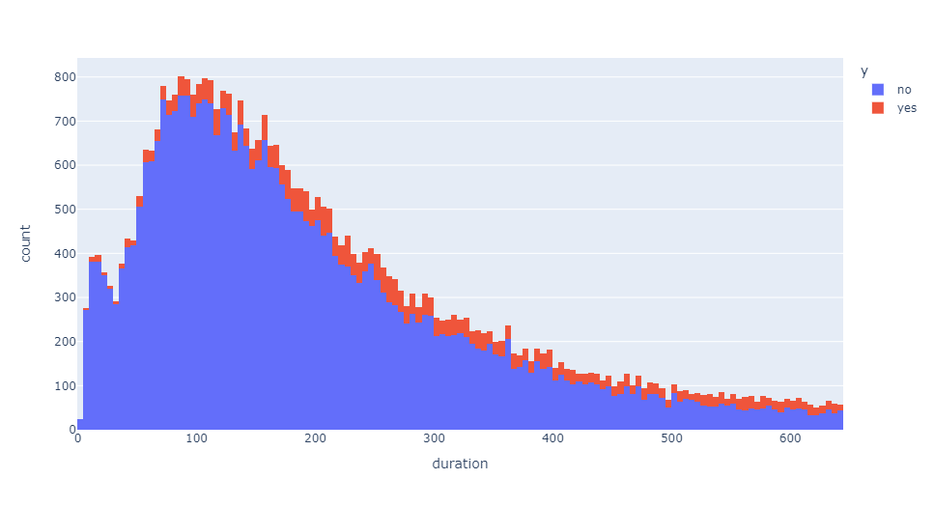
EDA – Numerical and Other Attributes
Campaign: Most of the numbers of contacts performed during the campaign and for the client were only once or twice.
Duration: The duration of the last contact is highly variated.

Slide 11
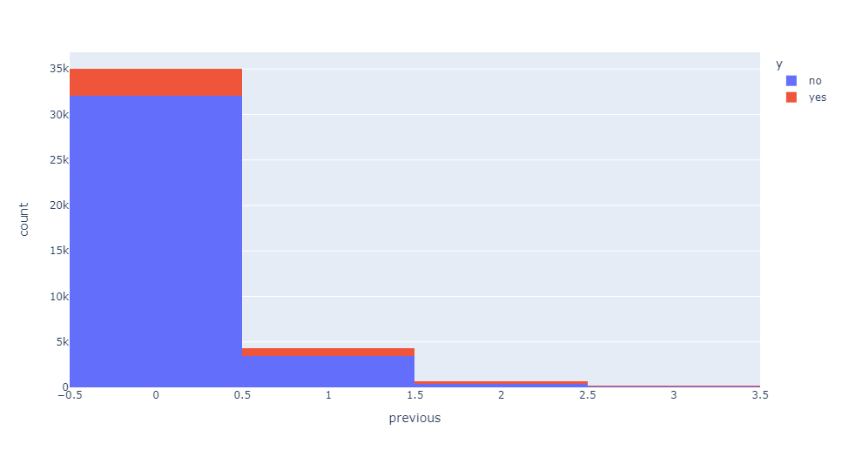
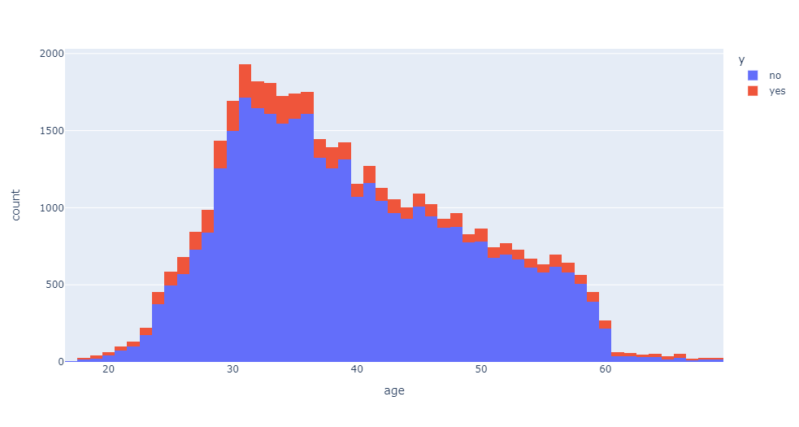
EDA – Numerical and Other Attributes
Previous: The number of contacts performed before this campaign and for a specific client was 0 in more than 80% of the cases
Age: Most of the people contacted was between 30 and 40 years old.

Slide 12
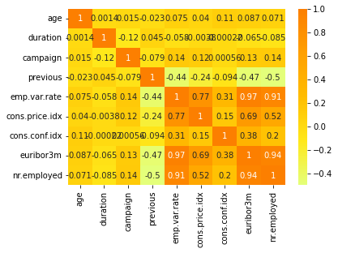
EDA – Numerical and Other Attributes
As we can see in this heatmap, the columns 'euribor3m', 'nr.employed' and 'emp.var.rate' are highly correlated.
You can see in the next page their graphics when comparing who did and who did not subscribe to a term deposit.

Slide 13
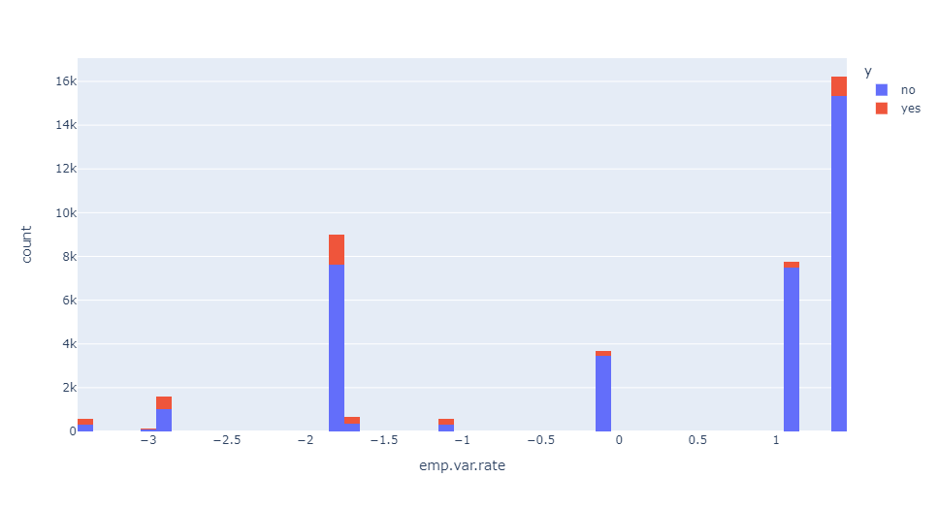
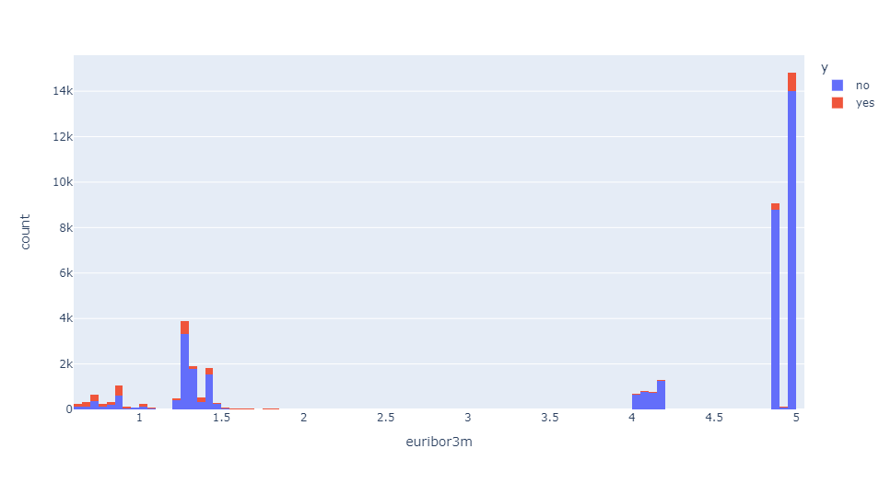
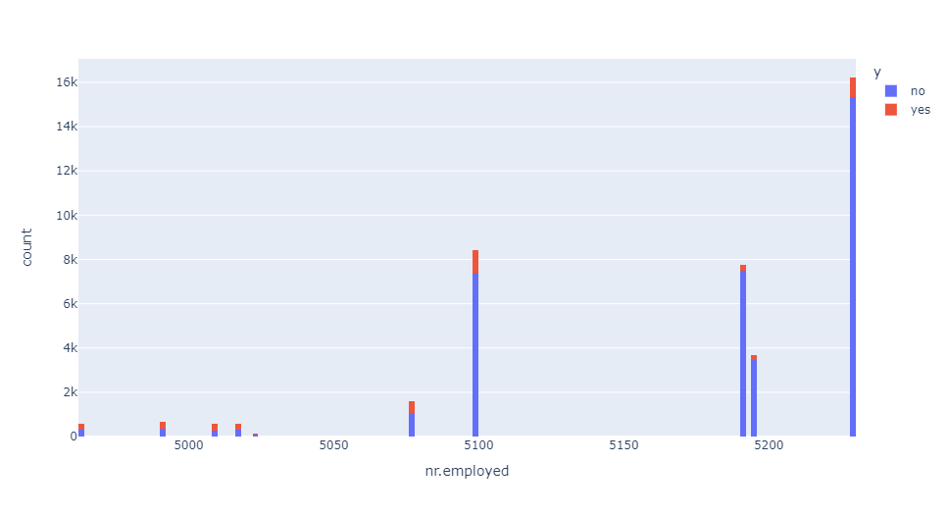
EDA – Numerical and Other Attributes

Slide 14
Encoding
How was the encoding done:
Columns “month” and “day_of_week” were turned into numbers (jan = 1, feb = 2; mon = 1, tue = 2)
Columns with values as “yes” and “no” and columns with 2 options (contact => telephone, cellular) were turned into 0s and 1s
Column “marital” had its values turned into 0s (married), 1s (single) and 2s (divorced)
Categorical features as “job” and “education” were turned into dummy variables
Numeric features were left as they are

Slide 15
Models
Choosing Metric
1. We are dealing with highly imbalanced dataset thus accuracy is not a good metric.
7328 | 1674
385 | 655
2. When choosing between recall and precision I thought about what is better for the bank: get less false positives or less false negatives
False positive is the situation when the model marked a customer as potentially positive and a call has been made, but the customer refused to open deposit. This leads to increase campaign direct costs
False negative is the situation when the model marked a customer as negative => he would not be called. But this customer would agree to open deposit if he will be called. So here bank is loosing income
The target is to reduce False Negatives
So the metric chosen is Recall

Slide 16
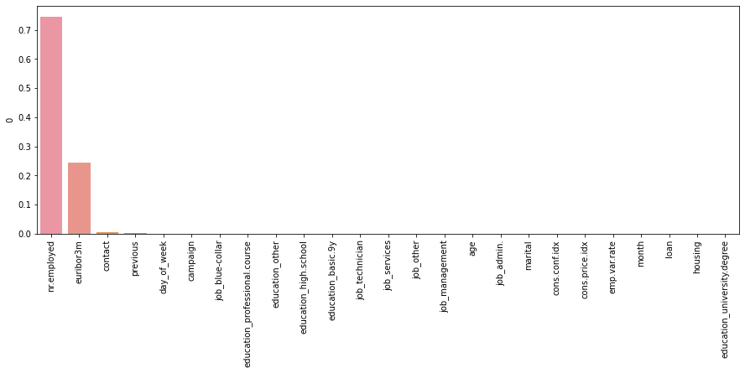
Models
Experimented models:
Logistic Regression
Decision Tree
Stochastic Gradient Descent
Random Forest
K Nearest Neighbors
Logistic Regression has the best results on almost all the datasets tested between the members of the group

Slide 17
Final Recommendations
Conclusion:
Best metric to evaluate the model was recall
The model that presented the best results is Logistic Regression
Final Recommendations:
Use Logistic Regression to reduce costs and time and call those who are more likely to open a deposit
The model can be tuned for better results
Target relatively old people
Try to engage customer and have long calls
Prefer mobile calls over telephone

Slide 18
GitHub Repo Link
https://github.com/sharuhinda/bank_marketing_campaign/tree/review
https://github.com/vgiih/EvolveData

Slide 19
Thank You!

